Slide 1
KPIs CDOs Should Know & Love
Kumar Srivastava
@kumarSSR
Bryan Kirschner
@apigeeinstitute
Apigee
@apigee
Notes:
Creative Commons Attribution-Share Alike 3.0 United States License

Slide 2


@kumarSSR
Kumar Srivastava
@apigeeinstitute
Bryan Kirschner

Slide 3
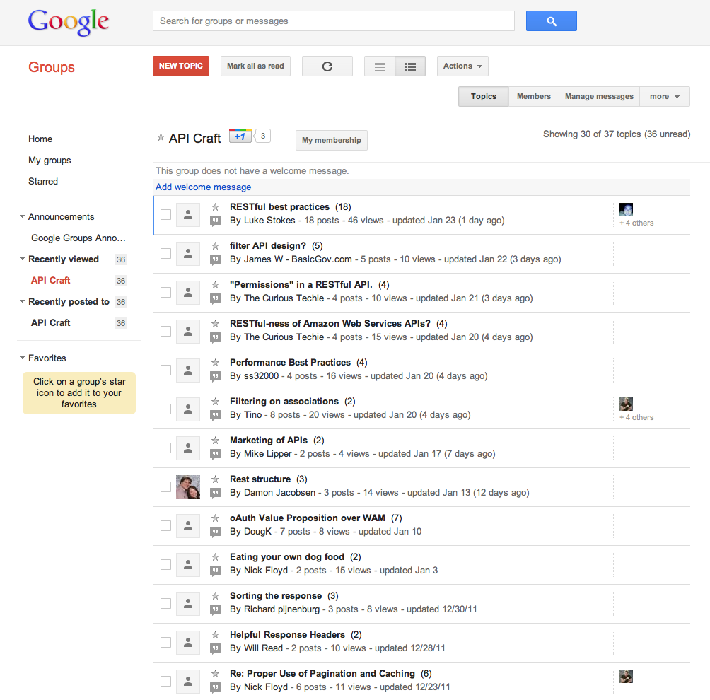
groups.google.com/group/api-craft

Slide 4
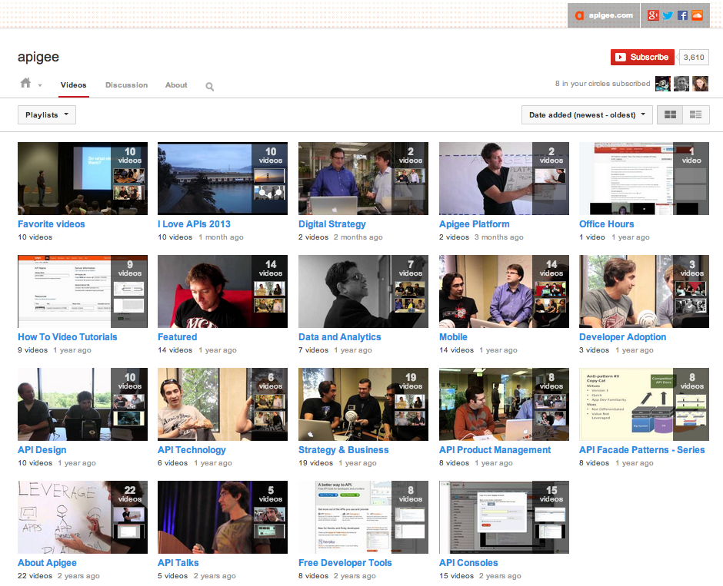
youtube.com/apigee

Slide 5
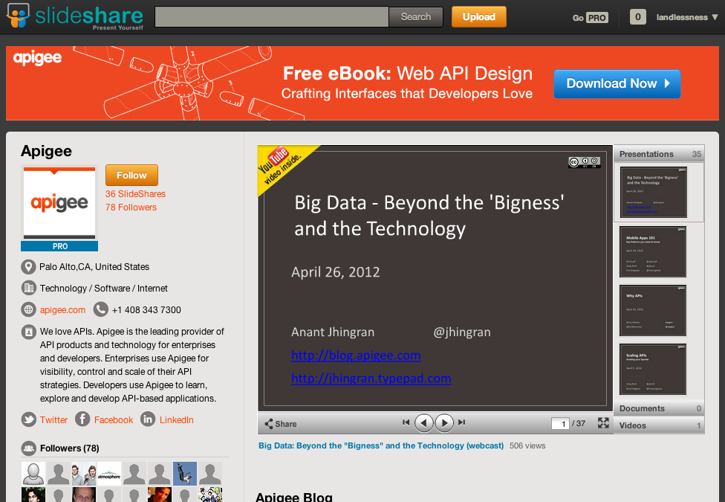
slideshare.net/apigee

Slide 6
Agenda: Excitement about KPIs
A proven pattern for digital business impact in any company
The KPIs every digital transformation leader should know (& love) to be successful
Case studies on choosing & using the right KPIs for your digital strategy

Slide 7
But wait, what’s different now?
(Is this just BI part XVII?)

Slide 8
Digital Transformation is here
Consumption patterns are changing
Ability to influence and enhance customer experience in real time is a competitive advantage
Ability to improve and adapt in real time is a competitive advantage
Notes:
It is not about the tools and analysis.
It is about the speed of analysis, action, decision by the decision makers/actors and to course correct in real time.

Slide 9
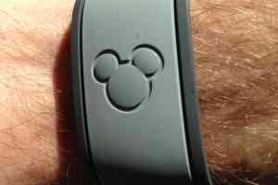
Notes:
How about Disney Magic Band scenarios as an example of predictive potential – see below:
Stop a moment and dream of the MagicBand possibilities.
The pitch that Disney is making is personalization. For each band, for example, Disney asks for the name and birthday of the person who’ll be wearing it. So if your kid is having a birthday in the park and there’s a character wandering nearby, that character can be notified to sneak up on your kid and creepily wish them a happy birthday individually.
Now, let’s dig a little deeper.
What does Disney get out of the deal? In short, it tracks everything you do, everything you buy, everything you eat, everything you ride, everywhere you go in the park. If the goal is to keep you in the park longer so you’ll spend more money, it can build AI models on itineraries, show schedules, line length, weather, etc., to figure out what influences stay length and cash expenditure. Perhaps there are a few levers they can pull to get money out of you.
Or perhaps its models know that your family is staying in a high-dollar luxury Disney resort and that this morning you forked over lots of money at the Cinderella character breakfast. But right now your high-dollar family is stuck in a long line at an attraction. If your family gets too tuckered out or frustrated, you might be inclined to call it a day.
So, a model marks you as a candidate for “encouragement.” Within the park, a character is notified to make its way over to your children and entertain them until they can get on the ride. This increases enjoyment, decreases perceived exhaustion, and hopefully keeps you around for more meals, more trinkets and more arcade games.

Slide 10
Patterns for Success

Slide 11
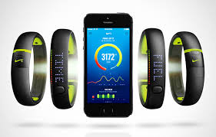
Nike #1 Most Innovative Company in 2013
Nike with Fuelband and Nike+
Revenues up 60%
Profits up 57%
Market cap 2 X
"Nike has broken out of apparel and into tech, data, and services, which is so hard for any company to do…”
-Sarah Rotman Epps, Forrester

Slide 12
“Digital Leaders” are doing this now across industries…
Digital Leaders
vs.
Digital Laggards…
Strong Outperformance In Last 12 Months…
Expected High Impact from Digital…
…on strength now deploying apps, operating APIs & using data analytics
…on margin, revenue, share customer satisfaction, or delivering new products and services
…that’s “big” over next 12 months, “increasing great deal” over next 5 years
Notes:
The most digitally mature companies are 26% more profitable, generate 9% more revenue and achieve 12% higher market valuations.” Wall Street Journal, November 2012

Slide 13
One key to leadership: a successful CDO (by any name)
No one title predominates….
% of companies with an appointed digital leader
Leaders
Laggards
Strong network
Flexible/adaptable
Simplifies complexity
Manages across departments well
…but there are 4 characteristics associated with the most effective CDOs
Source: Apigee Institute survey of 300 executives in companies with $500M+ annual revenue, September, 2013

Slide 14

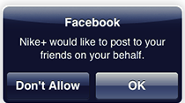
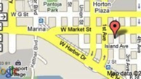










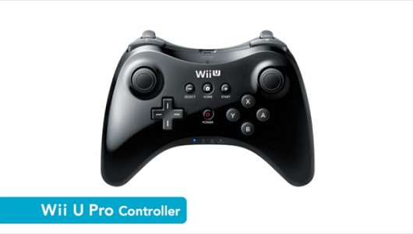
To the digital value network
Tablets
Wearable Electronics
Smart phones
Kiosks
Partner Integration
API
Your Digital Assets
API
API
Open Innovation
API
Connected Cars
Smart Sensors
Smart Appliances
Gaming Consoles
Notes:
Nike has mastered going from a liner, physical value chain to a digital value network
These KPIS are the building blocks for your dashboard for your unique strategy
Building blocks of your dashboard for the digital value network
The right dashboard = the ability to focus
On the problems that matter
For maximum impact
Through the right KPI
Fast
in data harvesting and analysis of every interaction with the customer And integrate these insights into their and their organizations’ day to day operations
Once you are there, but also how you lead/steer the journey –
Why are these KPIs important
This set is the superset of what you need to track
Broken up into efficiency, progress and impact
These KPIs offer a structure to focus on the right information required to succeed in the digital journey

Slide 15
6 Key Areas to Measure
Business
Channels
Digital Transformation Progress
Apps and APIs
Developers and Partners
Outreach and Perceptions

Slide 16
Case studies

Slide 17
1. KPIs for Business
Revenue Unique Users Usage
Notes:
Three key KPIs
Revenue – from your digital business
Unique Users –
Usage – of your digital assets that complement usage of your core product
Nike:
Revenue, Users
Product Strategy : Build digital assets that increase “usage” of Nike by users building engagement and stickiness. Usage beyond their core business and products

Slide 18
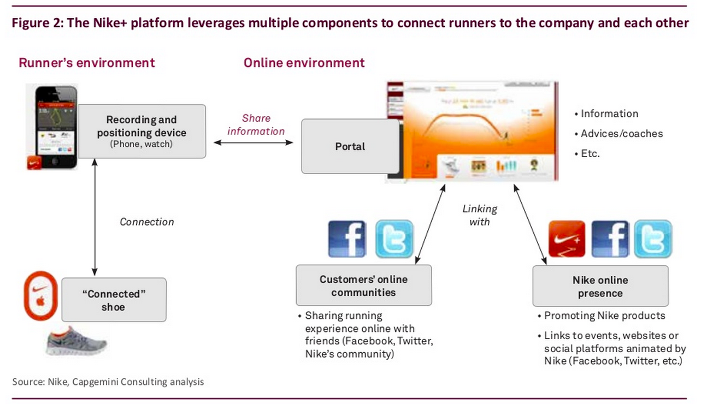
Nike+ has more than 11 million users
Notes:
How strongly can we make the connection between their users (which is clear), the usage (which is clear) and then their revenue?

Slide 19
2. KPIs for Digital Transformation Progress
Agility Innovation Ecosystem Density
Notes:
Walgreens
Strategy: Expose key services as APIs internally to offer new app driven use cases such as prescription refill, photo printing etc
but also drive new partnerships within and outside the company
Three key KPIs
Agility – rate of improvement
Innovation – rate of new apps and APIs to offer new products/services inside and outside the company
Ecosystem density – transform oneself as a key part of inter enterprise digital value chains

Slide 20

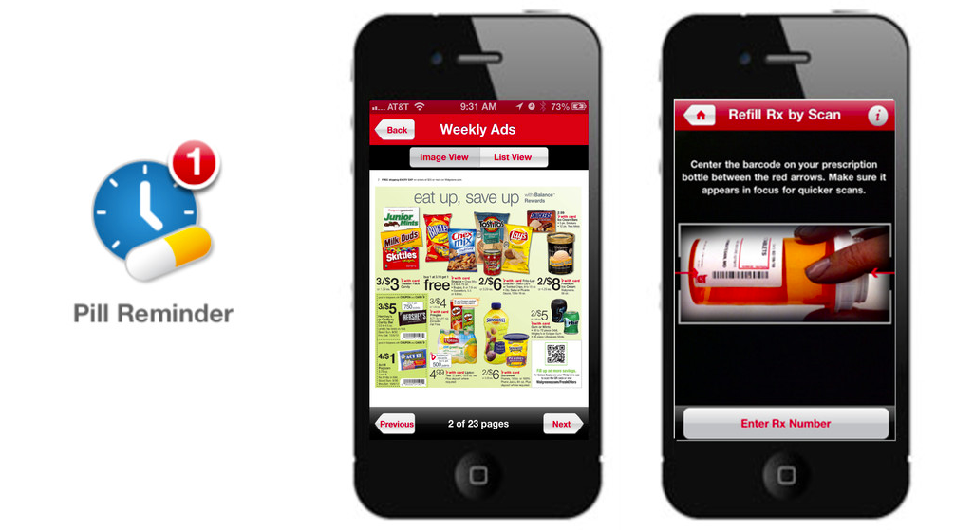
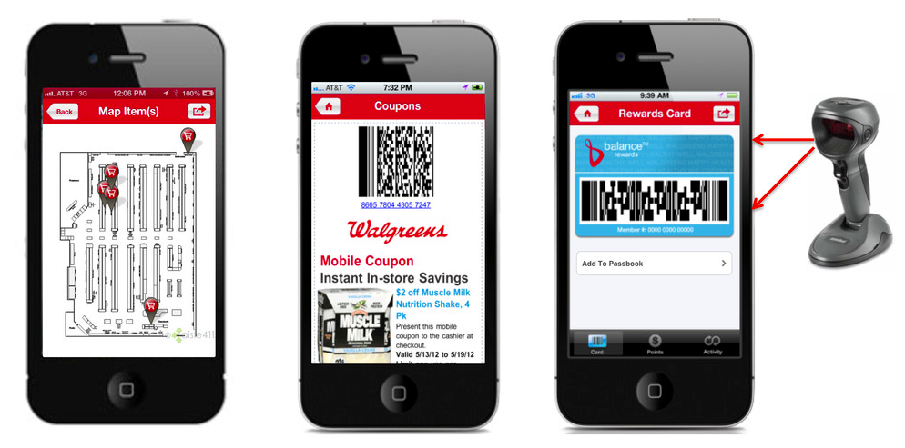
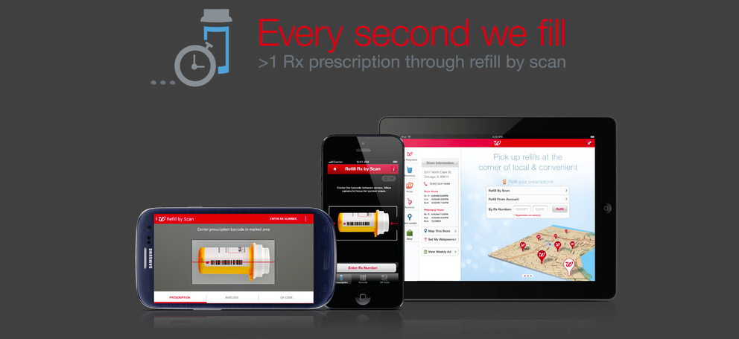
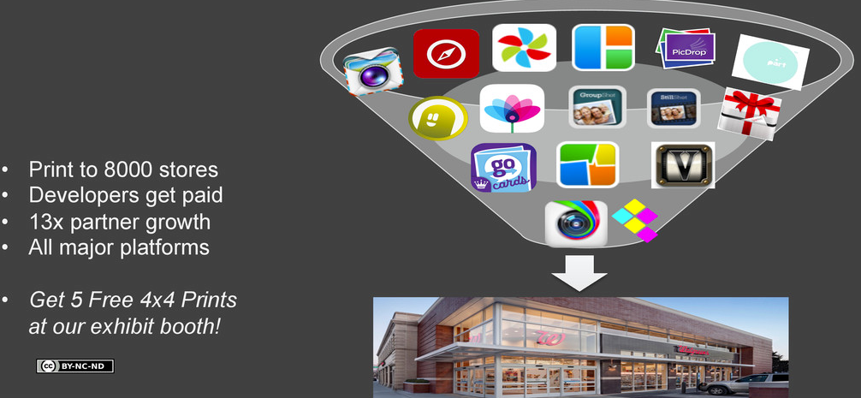
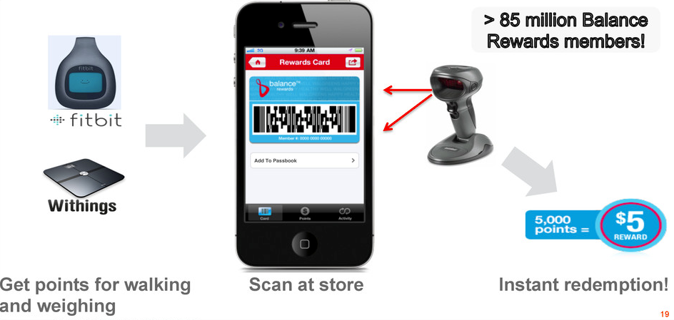

Slide 21
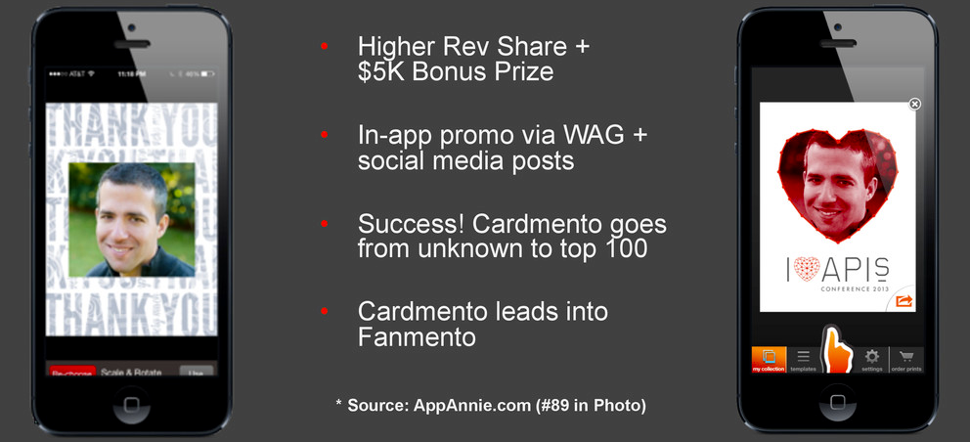
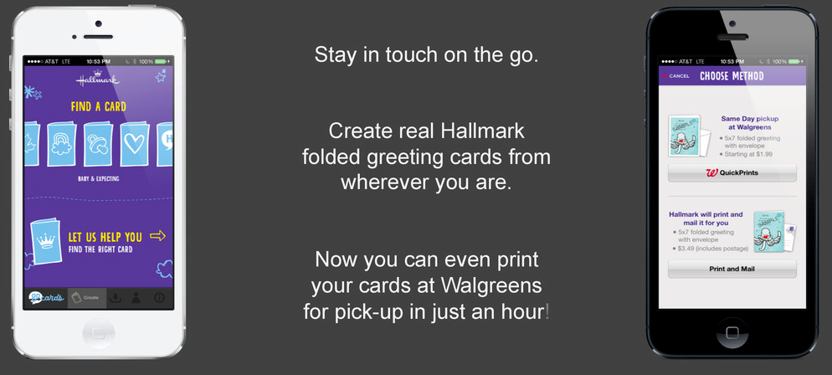
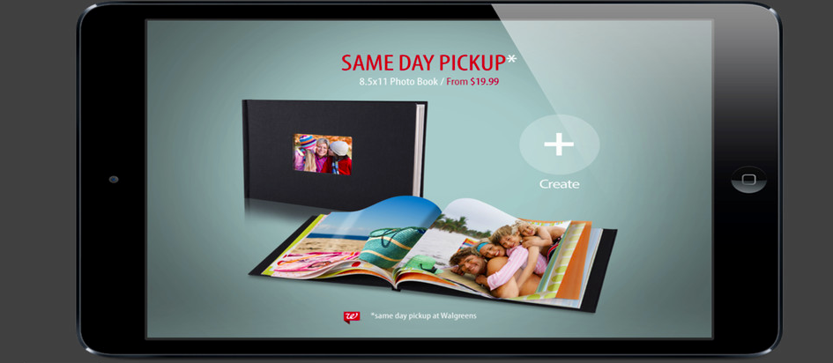

Slide 22
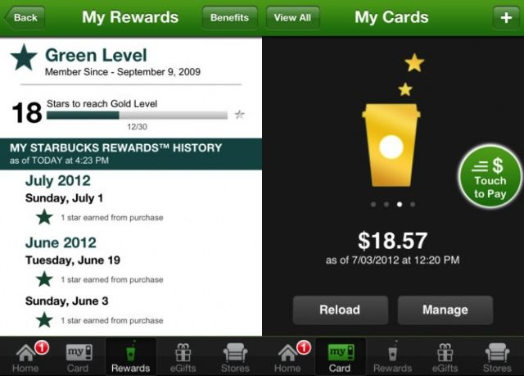
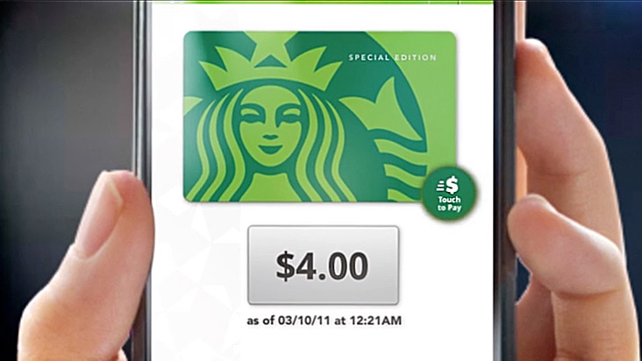

3. KPIs for Channels
Transaction Affinity Channel Adoption Channel Symbiosis
Notes:
Walgreens
Strategy: Expose key services as APIs internally to offer new app driven use cases such as prescription refill, photo printing etc
but also drive new partnerships within and outside the company
Three key KPIs
Agility – rate of improvement
Innovation – rate of new apps and APIs to offer new products/services inside and outside the company
Ecosystem density – transform oneself as a key part of inter enterprise digital value chains

Slide 23

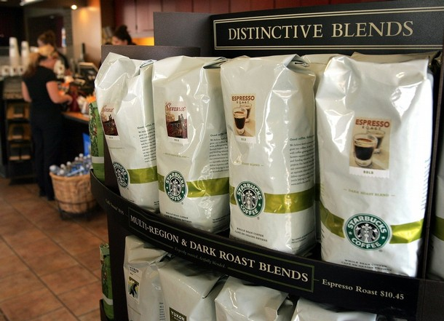
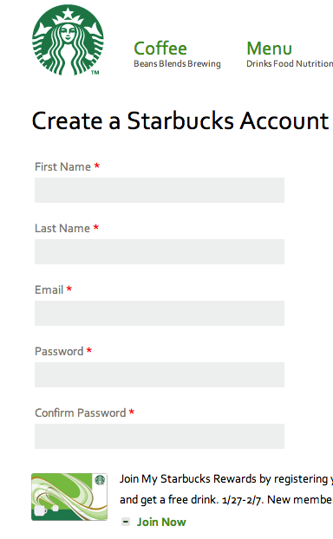
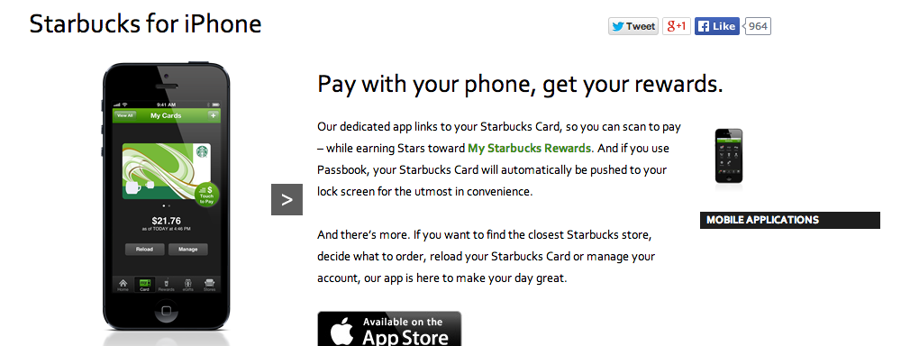
> 10 Million Active Users
> 2M Transactions per week

Slide 24

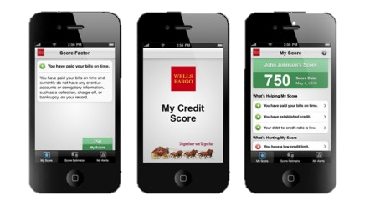
“Our customers choose Wells. You are not competing with your own channels. Channels should complement one another to help customers”
Brian Pearce, SVP Head of Retail Mobile Channels, Wells Fargo

Slide 25
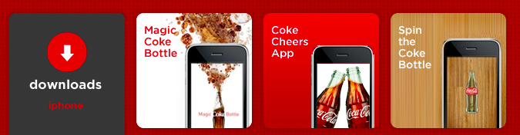
4. KPIs for Apps and APIs
Traffic
Usage
Revenue
Notes:
Coke
Strategy: Offer engaging user experiences though dozens of apps and app driven innovative experiences
Innovate in the app but also drive sales of core product and get the coke brand image as a cool, innovative product reinforced.
Three key KPIs
Traffic
Revenue
Usage

Slide 26





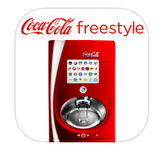

Slide 27
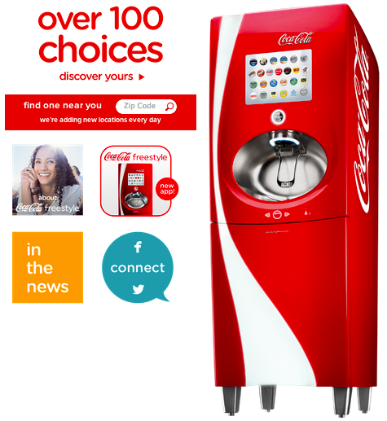
App Portfolio Collection of registered apps for an API platform in various stages of experimentation and development targeting varied user segments, use cases, channels and market

Slide 28
5. KPIs for Developers and Partners
Time to Success
Rate of Success
Engagement
Notes:
Apple
Strategy: Build a controlled but scalable developer platform enabling innovation and providing extremely rich and satisfying user experiences
Three KPIs
Time to Success (shorten it through docs, samples, webinars etc)
Rate of Success (increase by offering dev communities, knowledge sharing, nurturing programs etc)
Engagement (Increase stickiness by introducing developers to more features and capabilities)

Slide 29
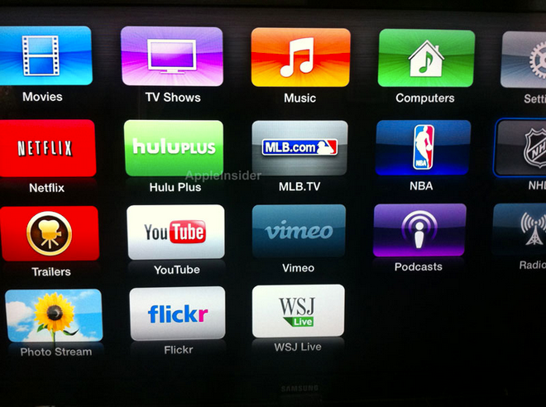

Slide 30

Developers and Partners
Rate of Success
Time to Success

Slide 31
6. KPIs for Outreach and Perceptions
App and API Releases
Developer Events
Social Media Perceptions
Social Media Interactions ⇒ Leading Indicator of Developer Perception Changes of API Programs
Notes:
Tracking and being transparent of upcoming releases so as not to surprise developers and users
Scanning and manning social media to control dissat and get alerted to potential issues
Tracking developer events and their efficacy and ROI

Slide 32
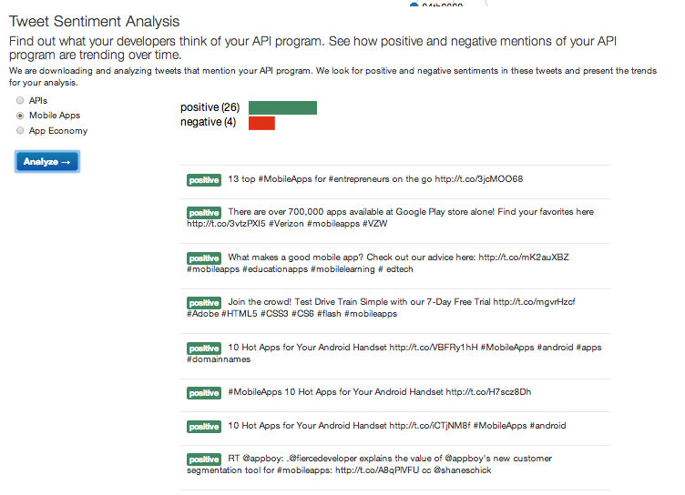

Slide 33
6 Key Areas to Measure
Business
Channels
Digital Transformation Progress
Apps and APIs
Developers and Partners
Outreach and Perceptions

Slide 34
Q&A
@kumarSSR
Kumar Srivastava
@apigeeinstitute
Bryan Kirschner

Slide 35
THANK YOU
Questions and ideas to:
@kumarSSR
@apigeeinstitute

